Slide 1
Equations of state of real gases:
Module3 (4 of 5)-MKM
IDEAL GAS AND REAL GAS
A gas which obeys Boyle’s law, Charle’s law etc under all condition of temperature and pressure is known as an ideal gas or a perfect gas.
Since the gas equation (PV=nRT) is obtained by combining Boyle’s law and Charle’s law, therefore, an ideal gas may also be defined as follows:
A gas which obeys the gas equation (PV=nRT) under all condition of temperatures and pressures is called an ideal gas. In fact, this is the reason that the gas equation (PV=nRT) is known as ideal gas equation.
A gas which obeys ideal gas equation or gas laws under low pressure or high temperature is known as Real gas. All gases are real gases. They show more and more deviation from the gas laws as the pressure is increased or the temperature is decreased.
Difference between Ideal and Real Gases:
S.No | Characteristics | Ideal Gas | Real Gas
1. | The attraction forces between gas molecules. | Not exists | Exists
2. | The actual volume of molecules in gas. | Negligible | Appreciable
3. | Molecular collision in a gas | Perfectly elastic | Non-elastic
4. | Confirms to the assumption of kinetic theory of gases. | Yes | No
5 | Obeys the Boyle’s law , Charle’s law etc | Under all condition of temperature and pressure | Only at low pressure and high temperature
6 | Existence of gas in reality | No(Only hypothetical) | Yes
7 | Examples | None | H2 , O2, N2 etc
1 | Page

Slide 2
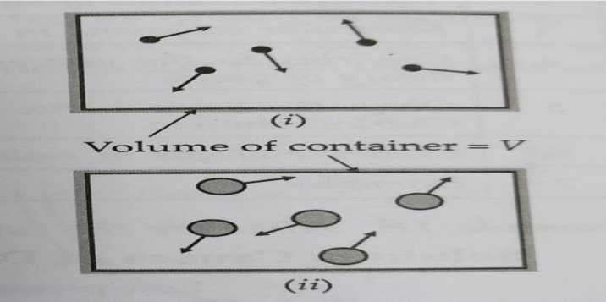
Equations of state of real gases:
Van der Waal’s in 1873 modified the ideal gas equation by incorporating correction terms, which took into account the volume of the gas molecules and the force of attraction between them.
Van der Waals equation modifies the kinetic theory of gases disproving the following points:
1. The force of attraction between gaseous molecules is negligible.
2. The volume of gaseous molecule is negligible as compared to the total volume of the gas.
The two corrections explained by Van der Waals are as follows :
(i) Correction for the volume
(ii) Correction for the force of attraction/Pressure correction
(i) Correction for the volume
Unlike volume of gas, volume of a molecule is not negligible.
Let us consider (n) moles of gas placed in a container of volume (V). If the volume occupied by the molecules themselves is negligible then the space in which the molecules are free to move is equal to (V), Fig.1 (i).
But in reality, the molecules have a finite size. Hence, the actual volume available to gas molecule for their free movement would be somewhat less than (V), Fig. 1
(ii) .
Fig1: Illustration of attraction forces between gas molecules
2 | Page

Slide 3
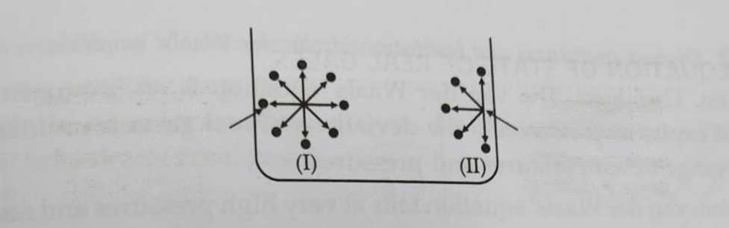
Let b= excluded volume or effective volume per mole of the gas n = number of moles of the gas
Hence, the actual volume for the free movement of gas molecule will be V_{idea}i Ideal Volume Videal = Measured volume (V) - Volume correct term (nb)
V ideal = V-nb--------------------------(i)
(ii) Correction for the force of attraction/Pressure correction
The force with which the molecules of the gas inside a container collide with the walls of the container is called the pressure of the gas. According to Van der Waals, the pressure of real gas is the combination of pressure developed due to collision of the molecules of gas with the walls of container and the pressure loss due to inward pull of adjacent molecules which makes the gas molecules striking the walls of the container experience some backward drag.
Balanced molecular
Net inward pull
attractions in the
experienced by
interior of a gas
a molecule about
(No net force)
to strike the wall
Fig 2: Illustration of attraction forces between gas molecules
Now consider the same gas molecule (A) moving towards the wall of the container. As it approaches the wall of the container, the uniform distribution of molecules around it is disturbed and it is attracted by molecules from the back side only. The molecule will thus experience a net inward force. Because of this, the molecule exerts less pressure as it is striking the wall of the container with lower velocity.
3 | Page

Slide 4
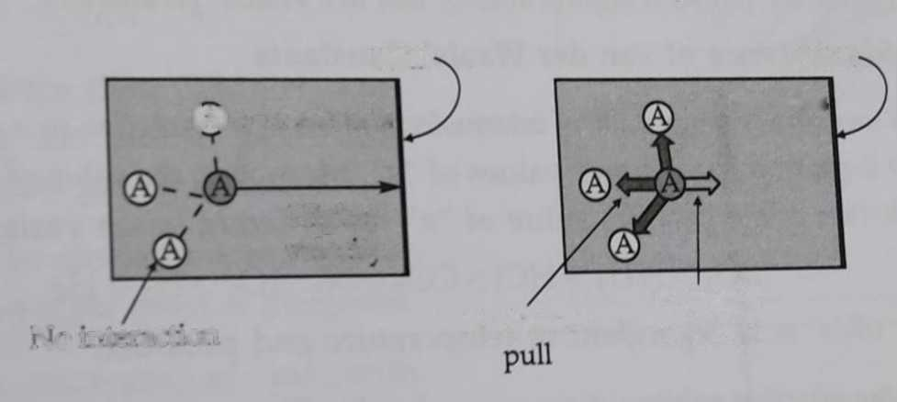
Wall
Wall
(A) t = x seconds
t = x seconds
Higher
veloatv
Backward
Reduced
No interaction
velocity
Fig3: The striking molecules is pulled inward (II) by other molecules which reduces its velocity and causes the decrease in pressure.
Hence, the measured pressure (p) is less than the ideal pressure. It is , therefore , necessary to add a correction term (po) to the measured pressure (p) in order to obtain the ideal pressure.
Hence, corrected (ideal pressure) pideal = p +po----------------(ii)
The pressure depends on (i) frequency of collisions with the walls and (ii) force of each collision.
Both the above term are reduced by the attraction forces, which act with a strength proportional to the molar concentration, n/V , of the molecule in the gas. Because, both the frequency and the force of collisions are reduced by the attraction forces, the pressure is reduced in proportion to the square of the concentration.
4 | Page

Slide 5
Hence, the correction term p ocf — V
' IvJ
Po where a is the constant of proportionality. PuHing this value p, in equation <*) „_{e} ge, the corrected (ideal) pressure :
Pideal ~ P + /
measured pressure
an
V²
\
(iii)
Since, the ideal gas equation is,
pressure correction factor to consider intermolecular forces
Pideal ^ideai ⁼ vRT
Substituting the values of p_{ideal} and V_{jdeal} from equations (iii) and (i) respectively in equation (;r), we get improved ideal gas equation.
an
.2 \ _
P+—y (V-nb) = nRT
-iv)
For this work, Johannes van der Waals (the Dutch chemist)
This is known as the van der Waals' equation for n moles of ^{was} awarded the Noble prize gas. The constants a and b are called van der Waals' constants. Physics in 1910.
Q. Discuss usefulness and limitation of Van der Waal’s equation.
Answer: Usefulness: The Van der Waal’s equation is an improvement over the ideal gas equation and explains qualitatively the deviation of real gases from ideal behaviour. It is valid over a wide range of temperature and pressure.
Limitation: Van der Wall’s equation fails at very high pressure and near critical temperature.
5 | Page

Slide 6
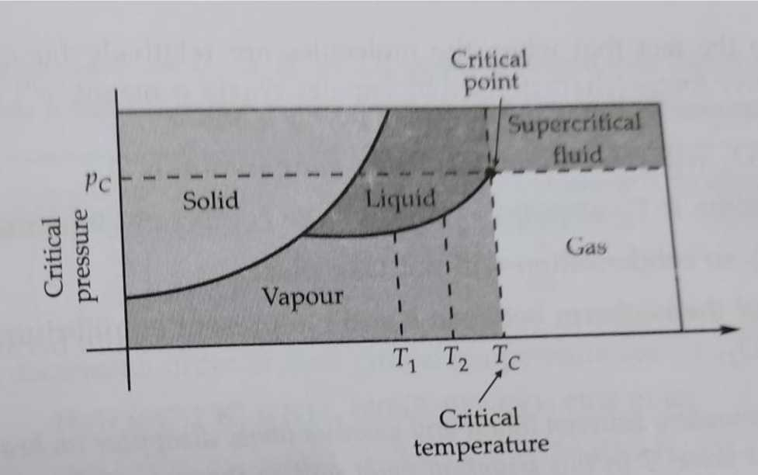
Critical phenomena:
At the critical point, the densities of a substance in liquid and gaseous state are same. There is no distinction between the liquid and gaseous state and no second phase is formed irrespective of the pressure of the system. Generally gases below their critical temperature are called vapours. Fluids above the critical temperature are known as super critical fluids, which dissolve many organic substances.
Super critical fluids are used for speedy separation of a mixture into its components. For examples, carbon dioxide above 600 bar pressure and above 31.1⁰C (Which is Tc for CO2) has a density around 1gm/cm³ and used to remove caffeine from coffee beans, instead of using chlorofluorocarbons , which are not environmental friendly.
6 | Page

Slide 7
Critical temperature:
The temperature above which gas cannot be liquefied using only high pressure is called critical temperature. It is denoted by T_{c}. For every gas, there is a specific critical temperature.
Tc = 8a/27Rb
Critical Volume:
The volume which is occupied by one mole of a gas at critical temperature is called critical volume. It is denoted by V_{c} .
Vc = 3b
Critical Pressure:
The minimum pressure at which a gas can be liquefied at critical temperature is called critical pressure. It is denoted by P_{c}.
Pc = a/27b²
PcVc = 3/8RTc
7 | Page

